Slide 1


Seminar Knowledge Graphs and Large Language Models
ESLM: Improving Entity Summarization by Leveraging Language Models
11.12.2024

Slide 2

Table of Contents
Why Entity Summarization?
Existing Approaches
ESLM: Architecture
ESLM: Experiment Settings
ESLM: Results
ESLM: Strengths, Weaknesses & Further Research Directions

Slide 3
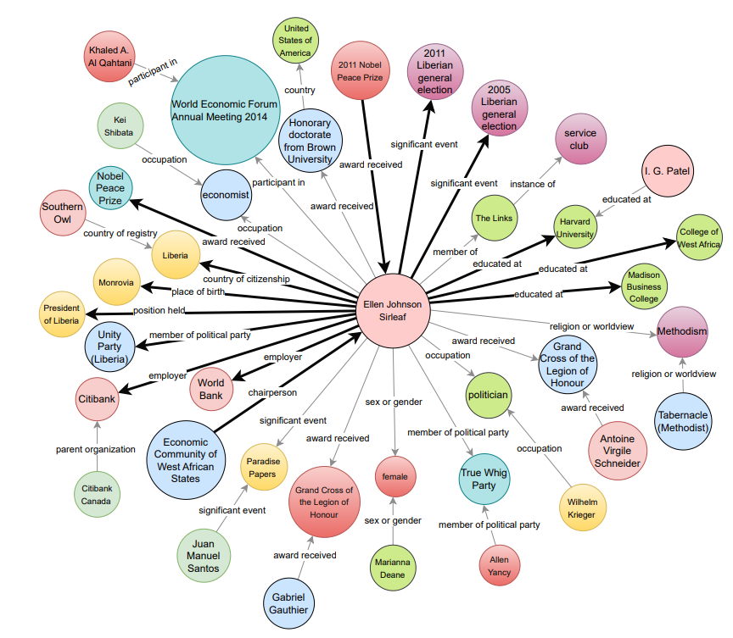

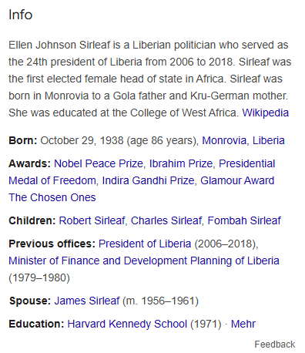

Why Entity Summarization? [1]
~ 54b entities
~ 1,600b triples
~ 30 triples/entity

Slide 4




Why Entity Summarization?
Desc(e,G)
$$t_{1}$$
e
e
$$t_{2}$$
e
$$t_{3}$$
e
$$t_{4}$$

Slide 5
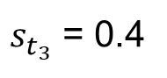
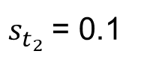
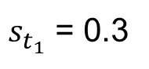
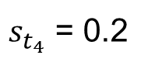
Why Entity Summarization?
Desc(e,G)
Triple Scoring
$$t_{1}$$
e
$s_{t_{1}}$ = 0.3
e
$$t_{2}$$
$s_{t_{2}}$= 0.1
e
$$t_{3}$$
$s_{t_{3}}$ = 0.4
e
$$t_{4}$$
$s_{t_{4}}$ = 0.2

Slide 6




Why Entity Summarization?
Desc(e,G)
ES(e)
Triple Scoring
Triple Selection
$$t_{1}$$
e
$$t_{1}$$
e
$s_{t_{1}}$ = 0.3
e
$k$ = 2
e
$$t_{2}$$
$s_{t_{2}}$= 0.1
$$t_{3}$$
e
$$t_{3}$$
$s_{t_{3}}$ = 0.4
e
$$t_{4}$$
$s_{t_{4}}$ = 0.2
Top $k$

Slide 7
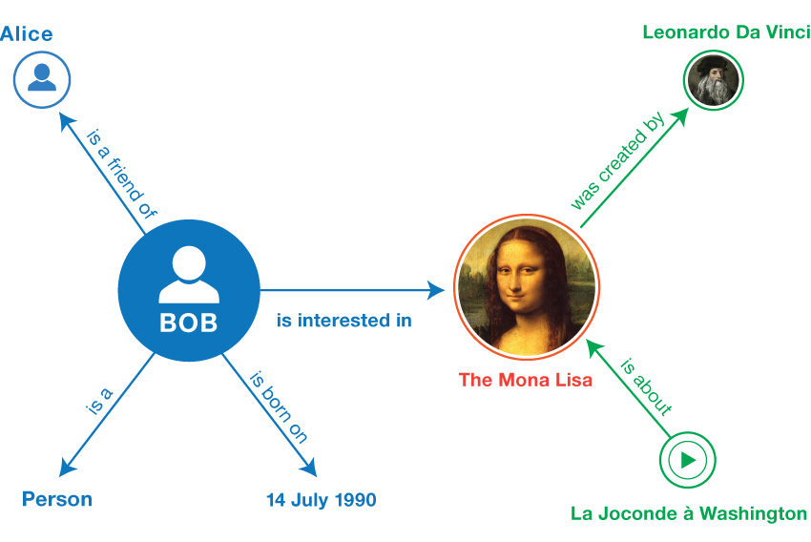
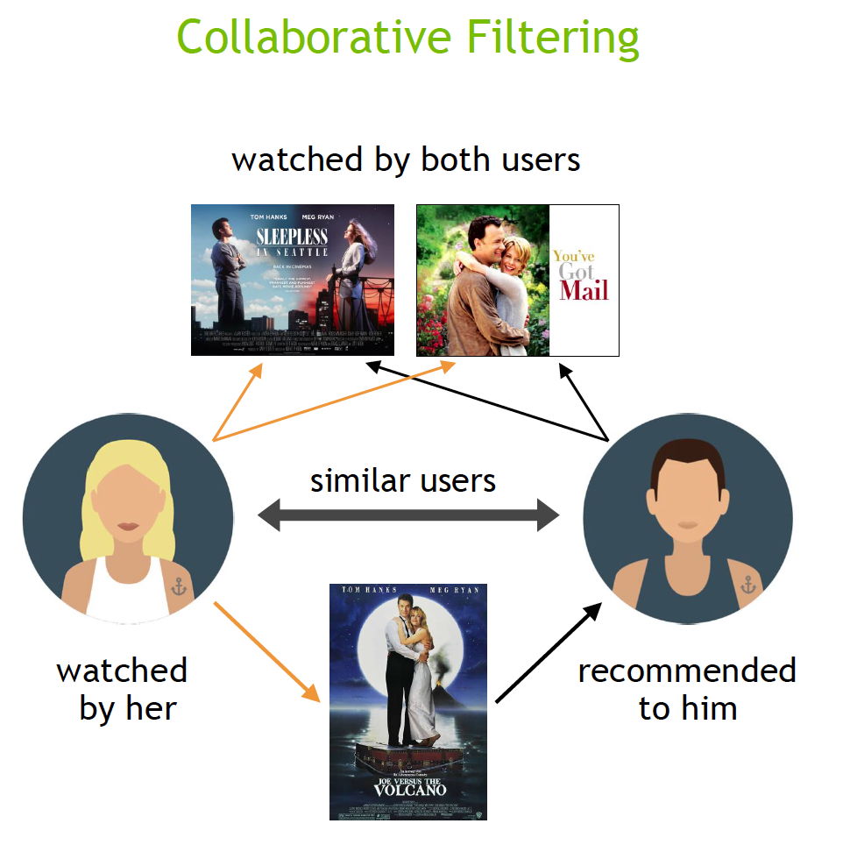
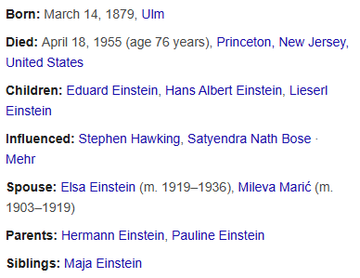

Why Entity Summarization? [2]
Web search
RDF browsers
Recommender systems
Provide concise overviews of entities
Summarization can be dynamic and query-aware
Help users to navigate through large RDF databases
Support exploration of underyling relationships
Integrate side information from KGs in case of data sparsity
Improve computational efficiency by creating summarized supernodes

Slide 8
Why Entity Summarization? [2]
Web search
RDF browsers
Recommender systems
Provide concise overviews of entities
Summarization can be dynamic and query-aware
Help users to navigate through large RDF databases
Support exploration of underyling relationships
Integrate side information from KGs in case of data sparsity
Improve computational efficiency by creating summarized supernodes

Slide 9
Why Entity Summarization? [2]
Web search
RDF browsers
Recommender systems
Provide concise overviews of entities
Summarization can be dynamic and query-aware
Help users to navigate through large RDF databases
Support exploration of underyling relationships
Integrate side information from KGs in case of data sparsity
Improve computational efficiency by creating summarized supernodes

Slide 10
Table of Contents
Why Entity Summarization?
Existing Approaches
ESLM: Architecture
ESLM: Experiment Settings
ESLM: Results
ESLM: Strengths, Weaknesses & Further Research Directions

Slide 11
Existing Approaches - Overview
Unsupervised Approaches
Deep Learning based Approaches
Leverage graph properties like frequency or centrality to identify key triples
Apply neural architectures (e.g. BiLSTM, GNN) to create contextually richer summaries
PageRank [2007]
DIVERSUM [2010]
RELIN [2011]
FACES [2015]
ESA [2019]
AutoSUM [2020]
NEST [2020]
DeepLENS [2020]
GATES [2021]
ESCS [2022]

Slide 12
Existing Approaches - Overview
Unsupervised Approaches
Deep Learning based Approaches
Leverage graph properties like frequencies or centrality to identify key triples
Apply neural architectures (e.g. BiLSTM, GNN) to create contextually richer summaries
PageRank [2007]
DIVERSUM [2010]
RELIN [2011]
FACES [2015]
ESA [2019]
AutoSUM [2020]
NEST [2020]
DeepLENS [2020]
GATES [2021]
ESCS [2022]

Slide 13
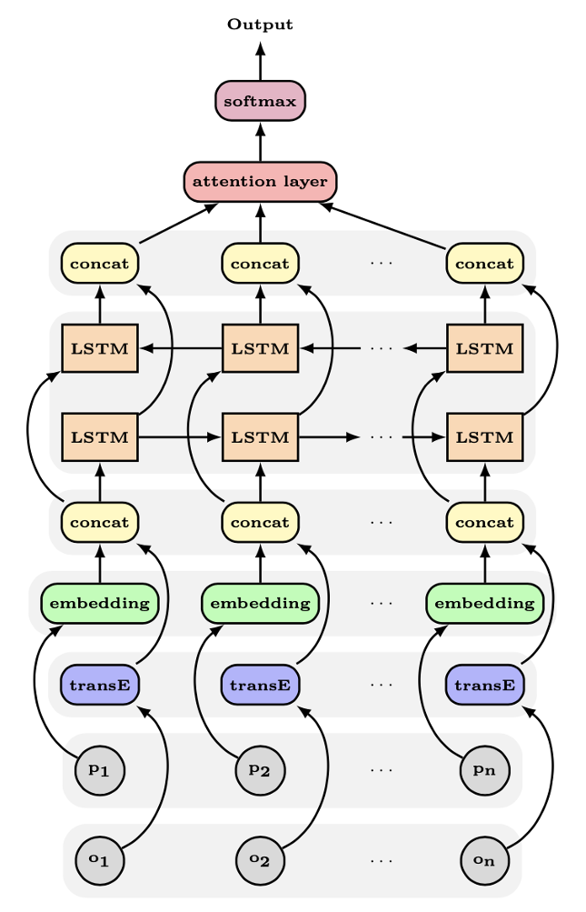
Existing Approaches – ESA [3]
ESA = Entity summarization with attention
Encoder-Decoder architecture
Encoder creates representation for each triple
Decoder takes input representations and assigns triple scores

Slide 14
Existing Approaches – ESA [3]
Each triple is represented by its predicate and object

Slide 15
Existing Approaches – ESA [3]
Predicate is encoded via word embedding (Neural probabilistic model)
Object is encoded via pre-trained knowledge graph embedding technique (TransE)
Embeddings are concatenated to form one unified representation per triple

Slide 16
Existing Approaches – ESA [3]
LSTM = Long short-term memory
Special kind of neural network that can retain information from other inputs
BiLSTM consists of:
Forward LSTM: Retains information from previous inputs
Backward-LSTM: Retains information form subsequent inputs

Slide 17
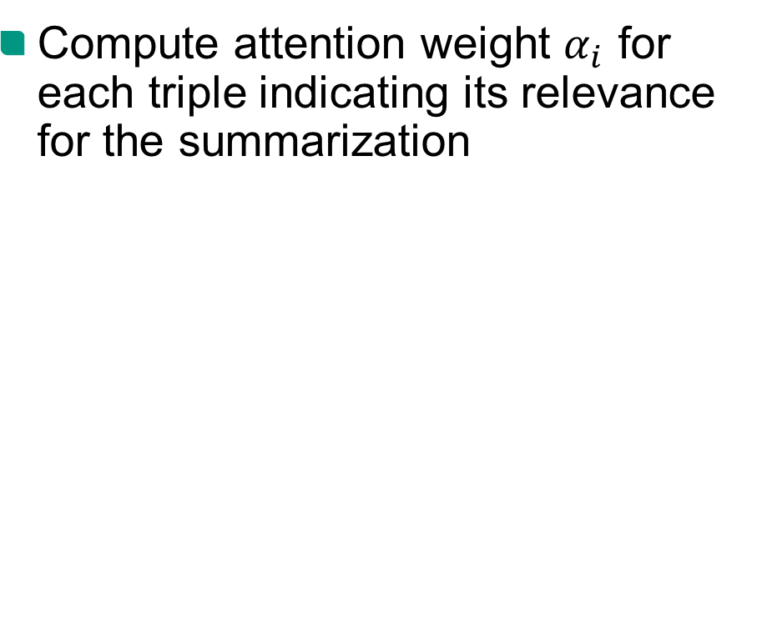
Existing Approaches – ESA [3]
Compute attention weight $α_{i}$ for each triple indicating its relevance for the summarization

Slide 18
Existing Approaches – ESA [3]
(-) Use of static word embedding which loses context information
(-) Division into predicate and object makes it more difficult to recognize dependencies
(-) Textual and graph embeddings are not properly integrated
(-) BiLSTM limits the approach with regard to processing performance

Slide 19
Existing Approaches – Research Questions
Hypothesis:
The use of language models can improve entity summarization
Research Question 1:
Which model configuration of ESLM achieves the best results?
Research Question 2:
Can ESLM outperform SOTA approaches?

Slide 20
Table of Contents
Why Entity Summarization?
Existing Approaches
ESLM: Architecture
ESLM: Experiment Settings
ESLM: Results
ESLM: Strengths, Weaknesses & Further Research Directions

Slide 21

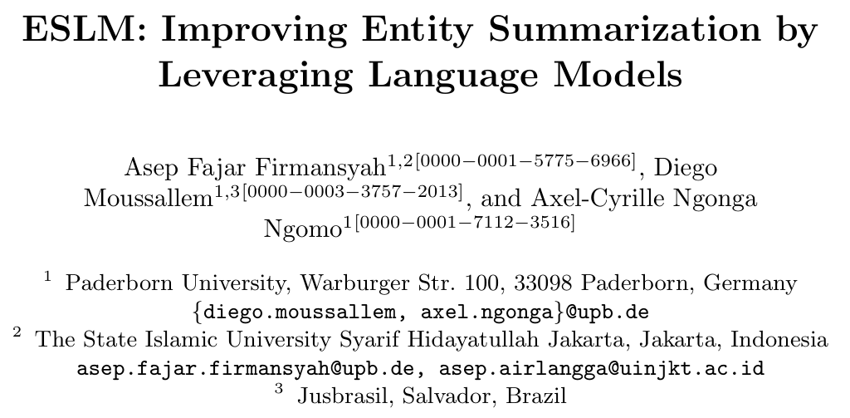


ESLM – Architecture [2]

Slide 22
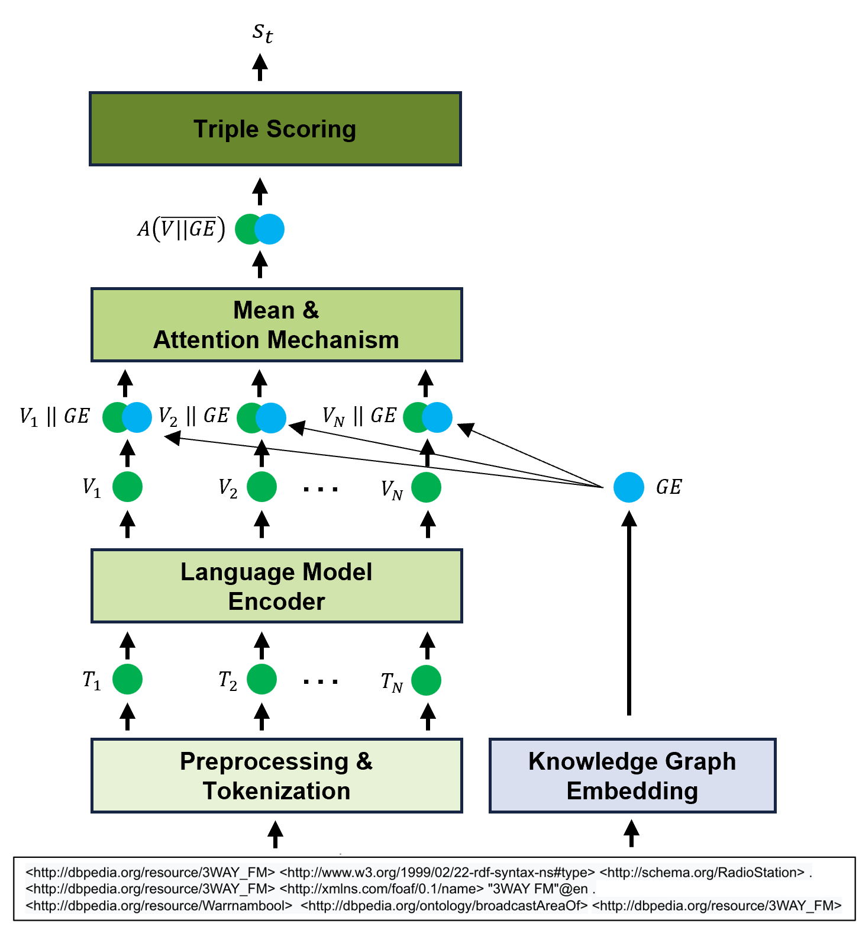
ESLM – Architecture [2]

Slide 23
ESLM – Architecture [2]
Input: RDF triples
Subject: <http://dbpedia.org/resource/3WAY_FM> Predicate: <http://www.w3.org/1999/02/22-rdf-syntax-ns#type> Object: <http://schema.org/RadioStation> .
Extract textual representation
Format into one string per triple
„[CLS] 3WAY_FM [SEP] type [SEP] RadioStation“
Tokenization
„[CLS]“ „3WAY“ „_FM“ „[SEP]“ „type“ „[SEP]“ „Radio“ „Station“

Slide 24
ESLM – Architecture [2]
Language Models:
ML models for understanding and generating natural language text
Modern language models are based on the transformer architecture
Encoder: Contextualized input representation
Decoder: Autoregressive output generation
Encoder-Decoder: Sequence-to-sequence tasks

Slide 25
ESLM – Architecture [2]
Language Models:
ML models for understanding and generating natural language text
Modern language models are based on the transformer architecture
Encoder: Contextualized input representation
Decoder: Autoregressive output generation
Encoder-Decoder: Sequence-to-sequence tasks

Slide 26
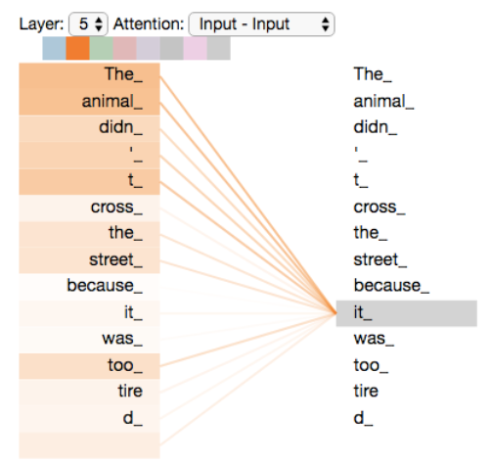
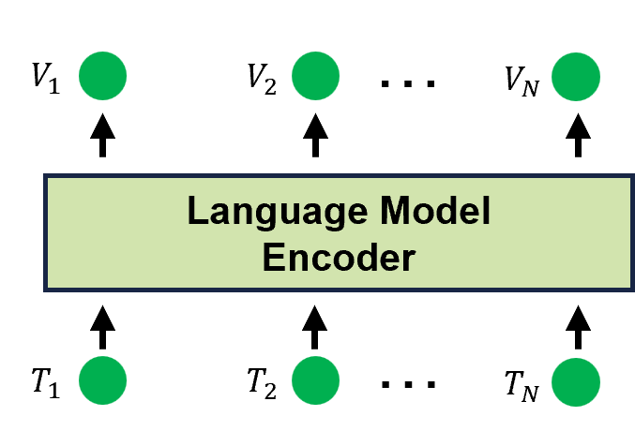
ESLM – Architecture [4]
Self-Attention:

Slide 27
ESLM – Architecture [6,7,8]
Pre-trained Models:
 | BERT | ERNIE | T5
Release | 10/2018 | 03/2019 | 10/2019
Architecture | Encoder | Encoder | Encoder-Decoder
Variant | Base | Base | Base
Model Size | ~ 110M | ~ 110M | ~ 220M/110M
# Heads | 12 | 12 | 12
# Transformer Blocks | 12 | 12 | 12
Hidden Dimension | 768 | 768 | 768

Slide 28
ESLM – Architecture [6,7,8]
Model comparison:
 | BERT | ERNIE | T5
Datasets | English Wikipedia, BooksCorpus | English Wikipedia, Wikidata | C4
Pre-Training Tasks | Masked Language Modeling (MLM), Next Sentence Prediciton (NSP) | MLM, NSP, Denoising Entity Auto-Encoder (dEA) | Denoising Objective (with Span Corruption)

Slide 29
ESLM – Architecture [6,7,8]
Model comparison:
 | BERT | ERNIE | T5
Datasets | English Wikipedia, BooksCorpus | English Wikipedia, Wikidata | C4
Pre-Training Tasks | Masked Language Modeling (MLM), Next Sentence Prediciton (NSP) | MLM, NSP, Denoising Entity Auto-Encoder (dEA) | Denoising Objective (with Span Corruption)
MLM Task: “Albert Einstein [MASK] the theory of [MASK].” => “Albert Einstein developed the theory of relativity.”

Slide 30
ESLM – Architecture [2]

Slide 31
ESLM – Architecture [2]
Knowledge Graph Embeddings:
Create vector representations for components of a knowledge graph
ComplEx:
Maps entities and relations into complex vector space
(+) Covers symmetric and antisymmetric relationships
(+) Computationally efficient

Slide 32
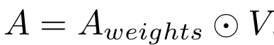
ESLM – Architecture [2]
Mean & Attention Mechanism:
Calculate Mean for concatenated embedding vector
Attention Mechanism
Assign importance weights to all elements of the input vector

Slide 33
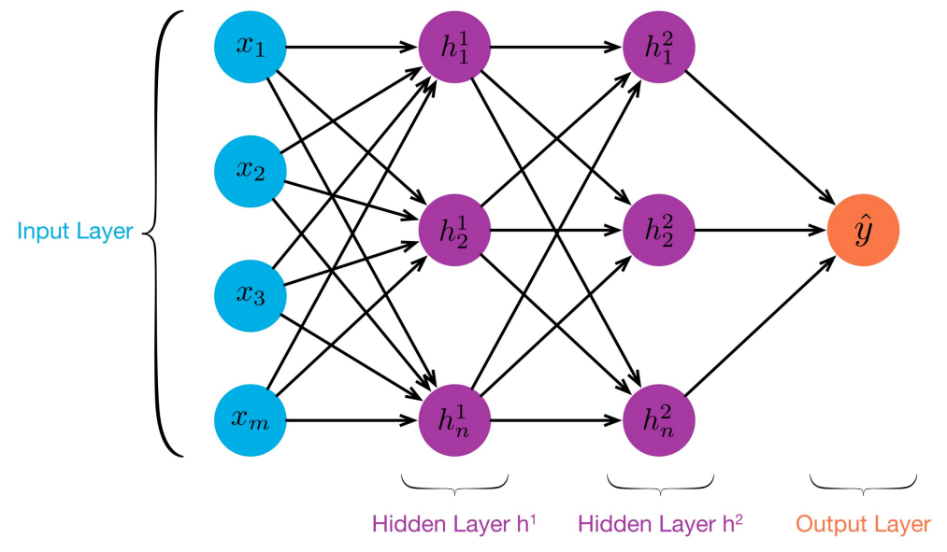


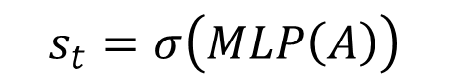
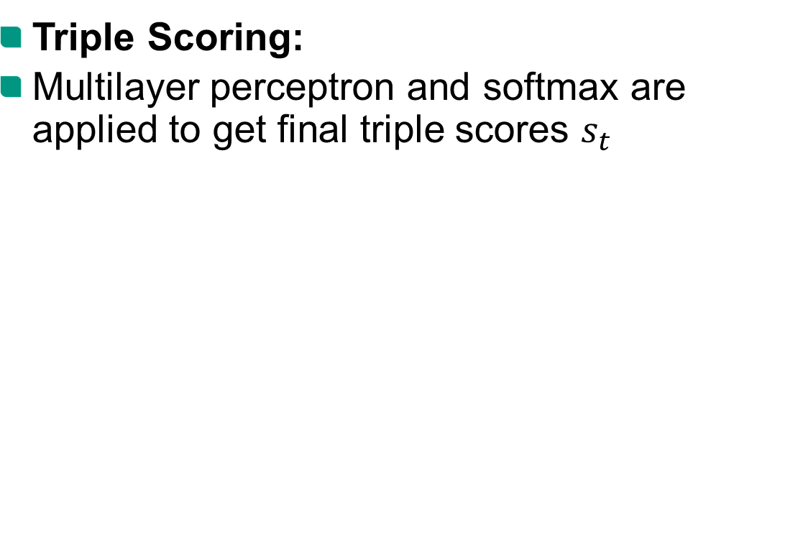
ESLM – Architecture [2]
Triple Scoring:
Multilayer perceptron and softmax are applied to get final triple scores $s_{t}$
$$d=1968$$
$$ⅆ_{h}=512$$
…
…
…
…
$$s_{t}=σ\left(MLP\left(A\right)\right)$$
…
…
…

Slide 34
Table of Contents
Why Entity Summarization?
Existing Approaches
ESLM: Architecture
ESLM: Experiment Settings
ESLM: Results
ESLM: Strengths, Weaknesses & Further Research Directions

Slide 35
ESLM – Experiment Settings [2]
Datasets:
 | DBpedia | LinkedMDB | FACES
Source | DBpedia | LinkedMDB | DBpedia
# Entities | 125 | 50 | 50
# Classes | 5 | 2 | 17
# Gold Solutions | 6 | 6 | >4

Slide 36
ESLM – Experiment Settings [2]
Configurations:
Model Configuration
LM Encoder: T5 | BERT | ERNIE
KGE: Yes | No
Dataset: DBpedia | LinkedMDB | FACES
Task: Top 5 | Top 10
Experiment Configuration

Slide 37
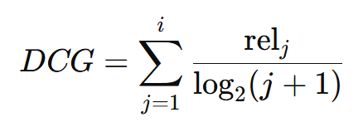
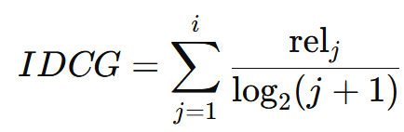
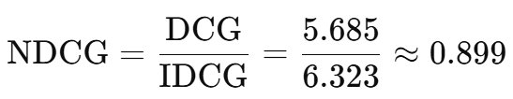
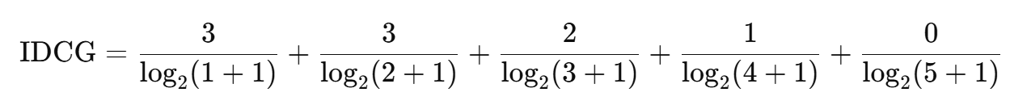
ESLM – Experiment Settings [2]
Evaluation Metrics:
Normalized Discounted Cumulative Gain (NDCG):
Triple | Rank by ESLM | Relevance Score
A | 2 | 3
B | 1 | 2
C | 4 | 3
D | 5 | 0
E | 3 | 1

Slide 38
Table of Contents
Why Entity Summarization?
Existing Approaches
ESLM: Architecture
ESLM: Experiment Settings
ESLM: Results
ESLM: Strengths, Weaknesses & Further Research Directions

Slide 39
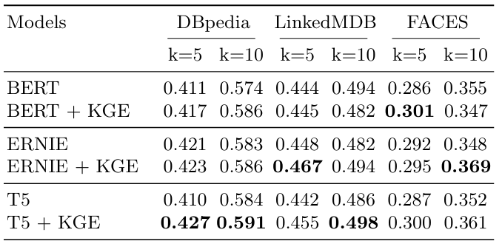
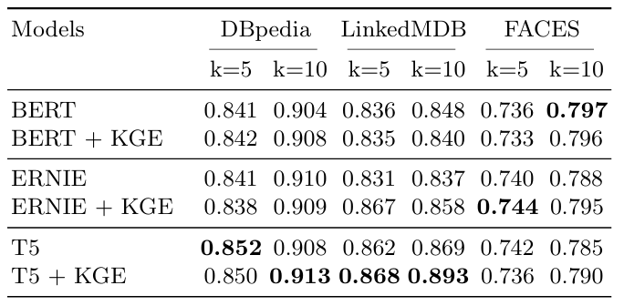
ESLM – Experiment Results [2]
Research Question 1:
Which model configuration of ESLM achieves the best results?
F-Measure
NDCG
Mean
Mean
0.427
0.827
0.430
0.826
0.429
0.825
0.439
0.835
0.427
0.836
0.439
0.842

Slide 40
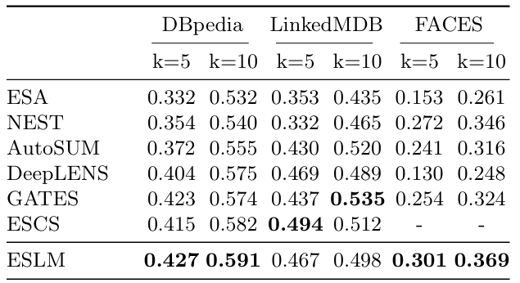
ESLM – Experiment Results [2]
Research Question 2:
Can ESLM outperform SOTA approaches?
F-Measure
Mean
0.344
0.385
0.406
0.386
0.425
-
0.442

Slide 41
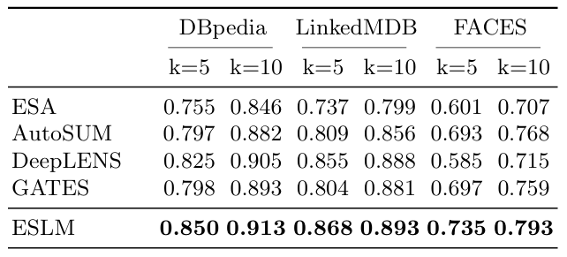
ESLM – Experiment Results [2]
Research Question 2:
Can ESLM outperform SOTA approaches?
NDCG
Mean
0.741
0.801
0.796
0.805
0.842

Slide 42
Table of Contents
Why Entity Summarization?
Existing Approaches
ESLM: Architecture
ESLM: Experiment Settings
ESLM: Results
ESLM: Strengths, Weaknesses & Further Research Directions

Slide 43
ESLM – Strengths [2]
(+) Good and robust performance on both evaluation metrics
(+) Architecture overcomes limitations of SOTA approaches

Slide 44

ESLM – Weaknesses [1]
Results/Methodology :
(-) Evaluation was only carried out on gold standard datasets with a limited size
Wiki Entity Summarization Benchmark (WikES)
Wikidata
Wikipedia
Triples (s,p,o)
Article references
WikiLitArt-s
494 entities
9 classes (Arts-related)
Evaluation on WikES-based benchmark dataset
Gold-standard solutions

Slide 45
ESLM – Weaknesses
Results/Methodology :
(-) Quantitative error analysis that would have provided valuable insights is missing

Slide 46
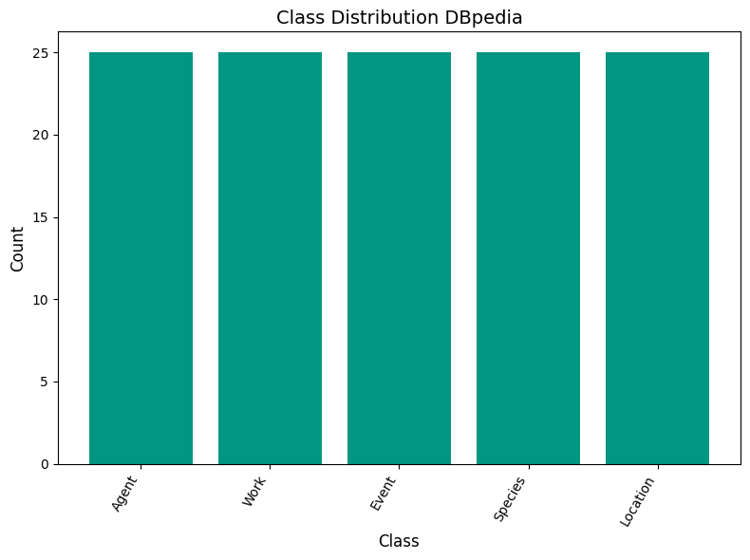
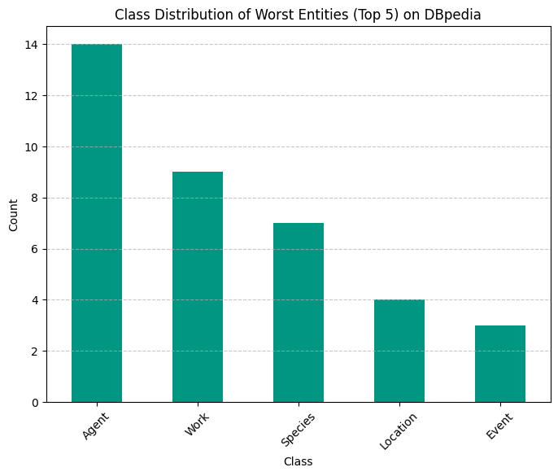
ESLM – Weaknesses
Error analysis for ESLM (T5 + KGE):

Slide 47
ESLM – Weaknesses [3]
Error analysis for ESLM (T5 + KGE):
F-Measure | Dbpedia Overall | Worst Entites Top 5 | Worst Entities Top 10
Node Degree Mean | 35.49 | 44.73 | 51.92
Node Degree Median | 31 | 39 | 50

Slide 48

ESLM – Weaknesses
Error analysis for ESLM (T5 + KGE):
Entity: Momchil Tsvetanov
Class: Agent
# Triples: 75
F-Score: 0.10
Analysis of in and out degree distribution
T5 + KGE:
Momchil Tsvetanov, team, PFC Spartak Pleven
Momchil Tsvetanov, team, PFC Botev Plovdiv
Momchil Tsvetanov, birthDate, „1990-03-12“
Momchil Tsvetanov, team, Bulgaria National Under 19
Momchil Tsvetanov, team, Bulgaria National Under 21
Gold-Standard Solution:
Momchil Tsvetanov, type, SoccerPlayer
Momchil Tsvetanov, name, Momchil Emilov Tsvetanov
Momchil Tsvetanov, position, Midfielder
Momchil Tsvetanov, birthPlace, Pleven
Momchil Tsvetanov, birthDate, „1990-03-12“

Slide 49
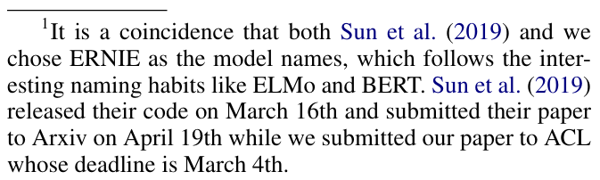
ESLM – Weaknesses [5,8,9]
Results/Methodology :
(-) Wrong ERNIE paper is referenced in the interpretation of results
ERNIE
– Enhanced Representation through Knowledge Integration –
Sun et al. (04/2019)
Baidu Inc
ERNIE 2.0
– A continual Pre-Training Framework for Language Understanding –
Sun et al. (11/2019)
Baidu Inc
ERNIE
– Enhanced Language Representation with Informative Entities –
Zhang et al. (04/2019)
Tsinghua University Beijing
Actually related
Referenced in the paper

Slide 50
ESLM – Weaknesses [2]
Architecture:
(-) ESLM lacks mechanism for cross-triple attention (in contrast to most SOTA approaches)
Relevance of a triple can depend on presence of other triples:
(Marie Curie, Married To, Pierre Curie) (Marie Curie, Collaborated With, Pierre Curie)
(Marie Curie, Discovered, Radium)
(Pierre Curie, Discovered, Radium)
…
Integrate second-level encoder for cross-triple attention

Slide 51
ESLM – Weaknesses [2]
Architecture:
(-) ESLM receives no direct context information about the summary to be created (e.g. class of the entity, user preferences)
Example Prompt:
„[entity_name], a [class], is being summarized. How relevant is the following triple? Subject – Predicate – Triple“
Provide LM encoder with context information through prompting

Slide 52
ESLM – Further Research Directions
Other LM encoders
Possible Experiments:
Prompting
Evaluation on WikES dataset
Further Error Analysis
ESLM
Graph Neural Networks (GNN)
Second-Level Encoder
Other KGE techniques

Slide 53
ESLM – Further Research Directions
Other LM encoders
Possible Experiments:
Prompting
Evaluation on WikES dataset
Further Error Analysis
ESLM
Graph Neural Networks (GNN)
Second-Level Encoder
Other KGE techniques

Slide 54
Literature Sources
[1] Javadi, S., Moradan, A., Sorkhpar, M., Zaporojets, K., Mottin, D., & Assent, I. (2024). Wiki Entity Summarization Benchmark. arXiv (Cornell University). https://doi.org/10.48550/arxiv.2406.08435
[2] Firmansyah, A. F., Moussallem, D., & Ngomo, A. N. (2024). ESLM: Improving entity summarization by leveraging language models. In Lecture notes in computer science (pp. 162–179). https://doi.org/10.1007/978-3-031-60626-7_9
[3] Wei, D., Liu, Y., Zhu, F., Zang, L., Zhou, W., Han, J., & Hu, S. (2019). ESA: Entity Summarization with Attention. arXiv (Cornell University). https://doi.org/10.48550/arxiv.1905.10625
[4] Alammar, J., & Grootendorst, M. (2024). Hands-On large language models: Language Understanding and Generation.
[5] Sun, Y., Wang, S., Li, Y., Feng, S., Tian, H., Wu, H., & Wang, H. (2019). ERNIE 2.0: A Continual Pre-training framework for language understanding. arXiv (Cornell University). https://doi.org/10.48550/arxiv.1907.12412
[6] Devlin, J., Chang, M., Lee, K., & Toutanova, K. (2018). BERT: Pre-training of Deep Bidirectional Transformers for Language Understanding. arXiv (Cornell University). https://doi.org/10.48550/arxiv.1810.04805
[7] Raffel, C., Shazeer, N., Roberts, A., Lee, K., Narang, S., Matena, M., Zhou, Y., Li, W., & Liu, P. J. (2019). Exploring the Limits of Transfer Learning with a Unified Text-to-Text Transformer. arXiv (Cornell University). https://doi.org/10.48550/arxiv.1910.10683
[8] Zhang, Z., Han, X., Liu, Z., Jiang, X., Sun, M., & Liu, Q. (2019). ERNIE: Enhanced Language Representation with Informative Entities. arXiv (Cornell University). https://doi.org/10.48550/arxiv.1905.07129
[9] Sun, Y., Wang, S., Li, Y., Feng, S., Chen, X., Zhang, H., Tian, X., Zhu, D., Tian, H., & Wu, H. (2019). ERNIE: Enhanced Representation through Knowledge Integration. arXiv (Cornell University). https://doi.org/10.48550/arxiv.1904.09223

Slide 55
Image Sources
Slide 8: Image of RDF browser (https://www.w3.org/TR/rdf11-primer/)
Slide 9: Image of Recommender System (https://www.nvidia.com/en-us/glossary/recommendation-system/)
Slide 23: Image of ESWC 2024 (https://2024.eswc-conferences.org/)
Slide 23: UPB Logo (https://www.uni-paderborn.de/)
Slide 23: UIN Logo (https://www.wikiwand.com/en/articles)
Slide 35: Image of MLP (https://engineering.purdue.edu/ChanGroup /ECE595/files/Lecture18_MLP.pdf)
Slide 50: Image of Soccer Player (https://en.wikipedia.org/wiki/Momchil_Tsvetanov)

Slide 56
Backup

Slide 57
Introduction

Slide 58
Contributions
(1) Introduction of a novel approach for entity summarization based on conctextual language models
(2) Detailed ablation study that identifies the best performing model configuration
(3) Conclusion that utilization of contextual language models and integration with KGE significantly outperforms SOTA

Slide 59
Challenges in Entity Summarization
Avoiding selection of redundant information
Scalability
Adapt summary to the users preferences and needs
Data Quality in knowledge graphs
Balancing structured and unstructured information
…

Slide 60

Why Entity Summarization?
Knowledge Graph $G$

Slide 61

Why Entity Summarization?
Knowledge Graph $G$
Entity $ⅇ$

Slide 62




Why Entity Summarization?
$$o_{4}$$
Knowledge Graph $G$
$$o_{1}$$
Entity $ⅇ$
Entities Literals Classes
$$o_{3}$$
$$o_{2}$$

Slide 63
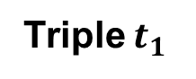
Why Entity Summarization?
$$o_{4}$$
Knowledge Graph $G$
$$o_{1}$$
Entity $ⅇ$
Entities Literals Classes
Subject
e.g. „Ellen J. Sirleaf“
Predicate
e.g. born_in
$$o_{3}$$
$$o_{2}$$
Triple $t_{1}$
Object
e.g. „Monrovia“

Slide 64
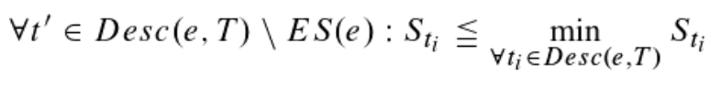
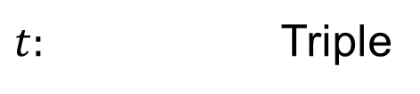
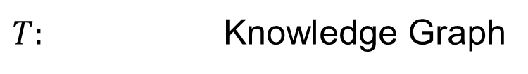
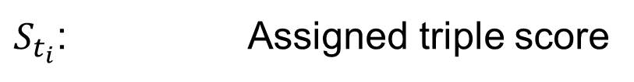
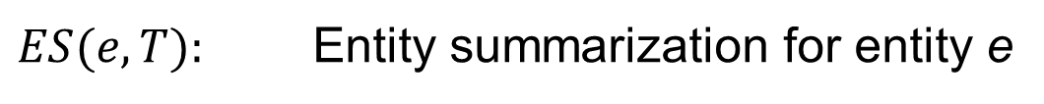
Entity Summarization - Formula
ES(e)
$t:$ Triple
$T:$ Knowledge Graph
$Desc(e,T):$ All triples in T associated with entity e
$ES(e,T):$ Entity summarization for entity e
$S_{t_{i}}$: Assigned triple score

Slide 65
Related Work

Slide 66
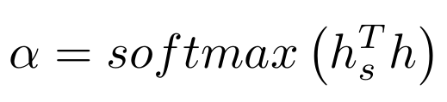
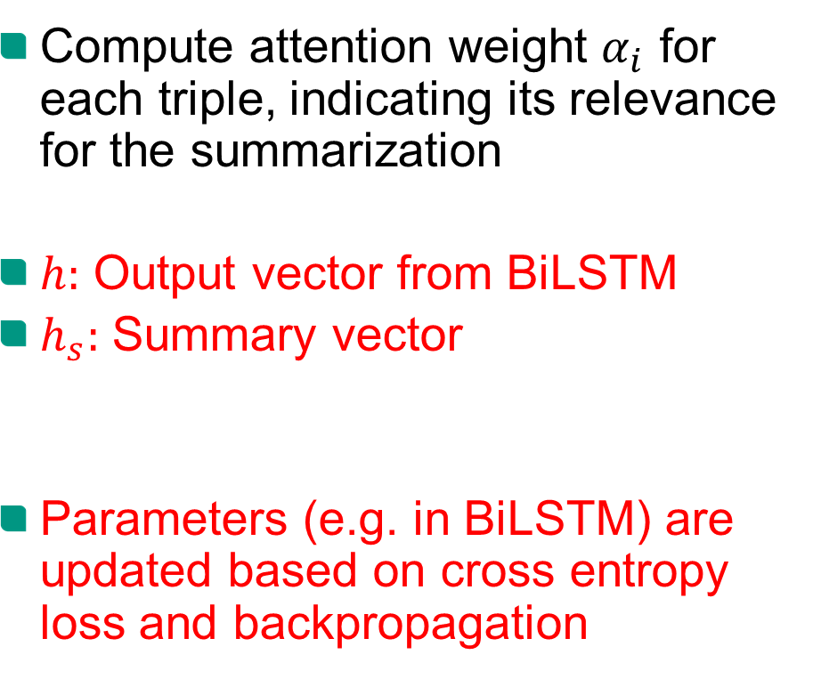
Existing Approaches – ESA (2019)
Compute attention weight $α_{i}$ for each triple, indicating its relevance for the summarization
$h:$ Output vector from BiLSTM
$h_{s}:$ Summary vector
Parameters (e.g. in BiLSTM) are updated based on cross entropy loss and backpropagation

Slide 67
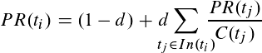

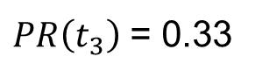
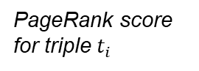

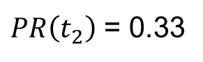
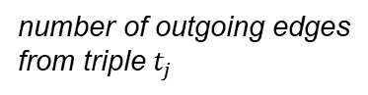
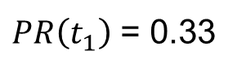
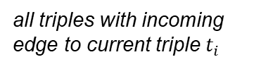

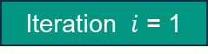
Existing Approaches – PageRank (2007)
$PR\left(t_{1}\right)$ = 0.33
Iteration $ⅈ$ = 1
$$t_{1}$$
$$t_{2}$$
$PR\left(t_{2}\right)$ = 0.33
constant damping factor
e.g. co-occurence, semantic similartiy
$PR\left(t_{3}\right)$ = 0.33
PageRank score for triple $t_{i}$
number of outgoing edges from triple $t_{j}$
$$t_{3}$$
all triples with incoming edge to current triple $t_{i}$

Slide 68
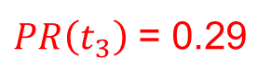
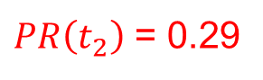
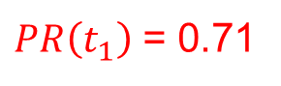
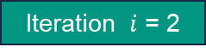
Existing Approaches – PageRank (2007)
$PR\left(t_{1}\right)$ = 0.71
Iteration $ⅈ$ = 2
$$t_{1}$$
$$t_{2}$$
Repeat until convergence…
$PR\left(t_{2}\right)$ = 0.29
constant damping factor
e.g. co-occurence, semantic similartiy
$PR\left(t_{3}\right)$ = 0.29
PageRank score for triple $t_{i}$
number of outgoing edges from triple $t_{j}$
$$t_{3}$$
all triples with incoming edge to current triple $t_{i}$

Slide 69
Existing Approaches – PageRank (2007)
$PR\left(t_{1}\right)$ = 0.71
Iteration $ⅈ$ = 2
(-) Operates solely on graph structure, lacks semantic understanding of context and content
$$t_{1}$$
$$t_{2}$$
Repeat until convergence…
$PR\left(t_{2}\right)$ = 0.29
constant damping factor
e.g. co-occurence, semantic similartiy
$PR\left(t_{3}\right)$ = 0.29
PageRank score for triple $t_{i}$
number of outgoing edges from triple $t_{j}$
$$t_{3}$$
all triples with incoming edge to current triple $t_{i}$

Slide 70
Existing Approaches – AutoSUM (2020)
Extractor:
Triple Encoding via Word Embedding and KGE
BiLSTM
Simulator:
Entity-Phase Attention:
Stacked attention layers
Each layer scores a differenct aspect of the entity (e.g. physical properties)
User-Phase Attention:
One preference layer for each user preference
Preference weight based on how similiar user preference is to other preferences

Slide 71

Existing Approaches – NEST (2020)
KG Encoder:
Average of Word Embedding for Subject, Predicate, Object
BiLSTM
Entity Summary Scorer (ESS):
Salience Triple Scorer (STS):
Each triple should describe an important feature
Diversity Summary Scorer (DSS):
Triples should describe different aspect of the entity

Slide 72

Existing Approaches – DeepLENS (2020)
Triple Encoding:
Word Embedding for Predicate and Object
Focus only on textual data
Entity Description Encoding:
Pass all triples through MLP
Attention weights with regard to current triple (if triple was included)
Entity Description via weighted sum
Triple Scoring:
Final MLP is applied to Triple and Entity Description Encoding

Slide 73

Existing Approaches – GATES (2021)
Triple Encoding:
Create Triple Representation
Compute Adjacency Matrix
Graph Attention Network (GAT):
Triples are represented by nodes
Attention weights between triples are calculated
Update of node features based on surrounding nodes (weighted sum)
Triple Scoring:
Ensemble GAT Learner

Slide 74
Existing Approaches – ESCS (2022)
Description Embedding:
Entity encoded via word embedding
Triple encoded via MLP and word embedding for predicate and object
Summary Complementary Learning (SCL):
BiLSTM is applied to triple embeddings
Each triple is scored based on hidden states from forward and backward LSTM (focusing on complementarity)
Description Salience Learning (DSL):
Each triple is scored based on cosine similarity with entity embedding
First triple is selected via DSL
Subsequent triples are selected via SCL (with regard to first triple)

Slide 75
Architecture

Slide 76
ESLM – Architecture
Static word embedding
Division into predicate and object
Integration of textual and graph embeddings
BiLSTM limitations
Contextual embeddings from language model
Encode triple as a whole
Integration via attention layer
Process triples independently from each other

Slide 77
ESLM – Architecture
Input: RDF triples
Step 1: Get textual representation
Option A: Take rdfs:label
Option B: Take local name
Subject: <http://dbpedia.org/resource/3WAY_FM> Predicate: <http://www.w3.org/1999/02/22-rdf-syntax-ns#type> Object: <http://schema.org/RadioStation> .
Subject: „3WAY_FM“ Predicate: „type“ Object: „RadioStation“

Slide 78
ESLM – Architecture
Step 2: Create formatted triple strings
Add [CLS] and [SEP] tokens
Step 3: Tokenization
Convert string into model-readable units
Tokenizer has to match respective language model
„[CLS] 3WAY_FM [SEP] type [SEP] RadioStation“
„[CLS]“ „3WAY“ „_FM“ „[SEP]“ „type“ „[SEP]“ „Radio“ „Station“
101, 12345, 6789, 102, 2345, 102, 4567, 8910

Slide 79

ESLM – Architecture
bank
transfer
Self-Attention:

Slide 80


ESLM – Architecture
Self-Attention:
$$Z= σ\left(\frac{QK^{T}}{\sqrt{d}}\right)V$$
Dynamically weigh importance of tokens in relation to each other
Capture local and global dependencies within the sequence

Slide 81
ESLM – Architecture
LLM Development Stages:
Pre-Training
Fine-Tuning
Utilization
Learn fundamental language skills and knowledge from large-scale datasets
Improve LM capabilities on certain tasks based on small datasets
Leverage LM capabilities through optimized prompts

Slide 82
ESLM – Architecture
LLM Development Stages:
Pre-Training
Fine-Tuning
Utilization
Take general-purpose LM that was pre-trained on large-scale data
Adapt LM to the specific task of entity summarization
on small dataset
Leverage LM capabilities through optimized prompts

Slide 83
ESLM – Architecture
Model comparison:
 | BERT | ERNIE | T5
Datasets | English Wikipedia, BooksCorpus | English Wikipedia, Wikidata | C4
Pre-Training Tasks | Masked Language Modeling (MLM), Next Sentence Prediciton (NSP) | MLM, NSP, Denoising Entity Auto-Encoder (dEA) | Denoising Objective (Span Corruption)
MLM Task: “Albert Einstein [MASK] the theory of [MASK].” => “Albert Einstein developed the theory of relativity”

Slide 84
ESLM – Architecture
Model comparison:
 | BERT | ERNIE | T5
Datasets | English Wikipedia, BooksCorpus | English Wikipedia, Wikidata | C4
Pre-Training Tasks | Masked Language Modeling (MLM), Next Sentence Prediciton (NSP) | MLM, NSP, Denoising Entity Auto-Encoder (dEA) | Denoising Objective (Span Corruption)
dEA Task: “Albert Einstein developed the theory of relativity”
“Albert Einstein” ⬄Albert Einstein => Albert Einstein “Theory of relativity” ⬄Theory of Mind => Theory of Relativity

Slide 85

ESLM – Architecture [5]
Model comparison:
 | BERT | ERNIE 2.0 | T5
Datasets | English Wikipedia, BooksCorpus | English Wikipedia, Discussion Data, … | C4
Pre-Training Tasks | Masked Language Modeling (MLM), Next Sentence Prediciton (NSP) | Continual Multi-Task-Learning (Knowledge Masking, Sentence Reordering, …) | Denoising Objective (Span Corruption)

Slide 86
ESLM – Architecture
Model comparison:
 | BERT | ERNIE | T5
Datasets | English Wikipedia, BooksCorpus | English Wikipedia, Wikidata | C4
Pre-Training Tasks | Masked Language Modeling (MLM), Next Sentence Prediciton (NSP) | MLM, NSP, Denoising Entity Auto-Encoder (dEA) | Denoising Objective (Span Corruption)
Denoising Objective Task: “<X> developed <Y> relativity” => “<X> Albert Einstein <Y> developed the theory of <Z>”

Slide 87


ESLM – Architecture
Knowledge Graph Embeddings:
Create vector representations for components of a knowledge graph
ComplEx:
Maps entities and relations into complex vector space
(+) Covers symmetric and antisymmetric relationships
(+) Computationally efficient
$$V=\left[\begin{matrix}1 \\ 3 \\ 3 \\ 5\end{matrix}\right]$$
$$V=\left[\begin{matrix}1+3i \\ 3+5i\end{matrix}\right]$$

Slide 88
Experiment Settings

Slide 89
ESLM – Experiment Settings
Datasets:
(1) ESBM v1.2
125 entities from DBpedia
50 entities from LinkedMDB
6 gold-standard summaries for each entity
(2) FACES
50 entities from DBpedia
At least 4 gold-standard summaries for each entity
DBpedia, LinkedMDB, FACES

Slide 90
ESLM – Experiment Settings
Datasets in more detail:
DBpedia:{
‘Event', 'Agent', 'Work', 'Species’, 'Location’
LinkedMDB:
‘film', 'Person’
Faces:
‘person, actor', 'country, place', 'person, athlete', 'person, politician', 'organization, sports', 'place, city', 'person', 'film', 'university, organization', 'software, game', 'country', 'place, state', 'tv show', 'company', 'person, scientist', 'river', 'song'

Slide 91


ESLM – Experiment Settings
FACES class distribution:

Slide 92
ESLM – Experiment Settings
DBpedia class distribution:

Slide 93

ESLM – Experiment Settings
LinkedMDB class distribution:

Slide 94

ESLM – Experiment Settings
Training:
Settings:
Framework: PyTorch
Optimizer: AdamW
Learning rate: $1 −5∗{10}^{−5}$
Scheduler: Linear decreasing learning rate (no warmup)
Epochs: 10
Loss: Binary Cross-Entropy (BCE)
Hardware:
CPU: 1 x AMD EPYC 7713 (64-core, 2.0 GHz)
RAM: 1024 GB
GPU: 2 x NVIDIA GeForce RTC A5000 (VRAM 24 GB)

Slide 95


ESLM – Experiment Settings
Evaluation Metrics:
F-measure:
Precision: What proportion of predicted triples is in gold-standard summary?
Recall: What proportion of triples from the gold-standard summary are correctly identified?
Balance between false positives (FP) and false negatives (FN)

Slide 96


ESLM – Experiment Settings
Evaluation Metrics:
Normalized Discounted Cumulative Gain (NDCG):
Discounted Cumulative Gain (DCG): Compute gain for ranking sorted by predicted triple scores $s_{t}$
Ideal Discounted Cumulative Gain (IDCG): Compute gain for ranking sorted by occurences in gold-standard summaries
High ranking quality, especially for the highest positions

Slide 97
ESLM – Experiment Settings
Training:
Cross Validation:
25 entities (DBpedia)
10 entitites (LinkedMDB, FACES)
Fold 0
1
2
3
4
5
Fold 1
1
2
3
4
5
Fold 2
1
2
3
4
5
Fold 3
1
2
3
4
5
Training
Validation
Testing
Fold 4
1
2
3
4
5

Slide 98
Results

Slide 99
ESLM – Experiment Results
Ablation Study:
F-Measure
NDCG
Mean
Mean
0.427
0.827
0.430
0.826
0.429
0.825
0.439
0.835
0.427
0.836
0.439
0.842
Performance increase from k=5 to k=10 of on average 22.98%
Performance increase with KGE of on average 2.05%
Performance increase from k=5 to k=10 of on average 5.17%
Performance increase with KGE of on average 0.58% (performance decrease for BERT)

Slide 100
ESLM – Experiment Settings
Wilcoxon-rank test for F-Measure:
Fold | ESLM | GATES | d | |d| | Rank | Signed Rank
1 | 0.427 | 0.423 | 0.004 | 0.004 | 1 | +1
2 | 0.591 | 0.574 | 0.017 | 0.017 | 2 | +2
3 | 0.498 | 0.535 | -0.037 | 0.037 | 4 | -4
4 | 0.467 | 0.437 | 0.030 | 0.030 | 3 | +3
5 | 0.301 | 0.254 | 0.047 | 0.047 | 5 | +5
H0: No significat performance difference
H1: Significant performance difference
W(+) = +1 +2 +3 +5 = 11
W(-) = -4 = 4
W = min(W(+), W(-)) = 4
=> Compare with critical value for number of folds and significance level

Slide 101

ESLM – Experiment Settings
Wilcoxon-rank test for F-Measure:

Slide 102
Review

Slide 103
ESLM – Strengths
Results/Methodology:
(+) On average ESLM outperforms SOTA approaches on both evaluation metrics
(+) Evaluation for several experiment configurations
(+) Cross Validation leads to more robust evaluation results
(+) Statistical test underlines the significance of the results

Slide 104
ESLM – Strengths
Architecture:
(+) Contextual embeddings from LM encoder preserves more contextual information from original triple
(+) Encoding triples as a whole gives model the opportunity to discover relationships within each triple
(+) More sophisticated fusion of textual and graph embedding information
(+) High scalability through individual processing of triples and use of performative LM encoders

Slide 105


ESLM – Weaknesses & Further Research Directions
Error analysis for ESLM (T5 + KGE):

Slide 106

ESLM – Weaknesses & Further Research Directions
Error analysis for ESLM (T5 + KGE):

Slide 107
ESLM – Weaknesses & Further Research Directions
Results/Methodology :
(-) Comparison with strongest competitor (ESCS) is not complete (due to lack of data)

Slide 108
ESLM – Weaknesses & Further Research Directions
Results/Methodology :
(-) Approach and results for third research question remain unclear
Research Question 3:
What impact do the integration of contextual language models have on the computational requirements?

Slide 109
ESLM – Weaknesses & Further Research Directions
Results/Methodology :
(-) Benchmark with SOTA approaches is biased by previous ablation study
F-measure
NDCG
Mean
Mean
0.427
0.827
0.430
0.826
0.429
0.825
0.439
0.835
0.427
0.836
0.439
0.842
Select T5 + KGE as benchmark model

Slide 110
ESLM – Weaknesses & Further Research Directions
Mean
Results/Methodology :
(-) Benchmark with SOTA approaches is biased by previous ablation study
F-Measure (Paper)
F-Measure (Modified)
Mean
Mean
0.344
0.344
0.385
0.385
0.406
0.406
0.386
0.386
0.425
0.425
-
-
0.442
0.427
0.591
0.455
0.498
0.300
0.361
0.439

Slide 111
ESLM – Weaknesses
Mean
Results/Methodology :
(-) Benchmark with SOTA approaches is biased by previous ablation study
NDCG (Paper)
NDCG (Modified)
0.741
0.741
0.801
0.801
0.796
0.796
0.805
0.805
0.842
0.850
0.913
0.868
0.893
0.736
0.790
0.842

Slide 112

Backup
ESLM Architecture:

Slide 113
…

Slide 114
ESLM – Weaknesses [2]
Architecture:
(-) ESLM lacks mechanism for cross-triple attention (in contrast to most SOTA approaches)
Context:
A summary of Marie Curie‘s research is to be created.
Triple to be scored:
(Marie Curie, Married To, Pierre Curie)
Other triples in entity description: (Marie Curie, Collaborated With, Pierre Curie)
(Marie Curie, Discovered, Radium)
(Pierre Curie, Discovered, Radium)
…

Slide 115
ESLM – Weaknesses [2]
Architecture:
Entity:
Battle of Zacatecas (1914)
Class:
Event
Context String: The entity Battle of Zacatecas (1914), a Event, is being summarized. How relevant is the following triple for this summary? [SEP]
Context String with Example Triple:
The entity Battle of Zacatecas (1914), a Event, is being summarized. How relevant is the following triple for this summary? [SEP] Battle of Zacatecas (1914) [SEP] isPartOfMilitaryConflict [SEP] Mexican Revolution

Slide 116
ESLM – Weaknesses [3]
Error analysis for ESLM (T5 + KGE):
F-measure | DBpedia Overall | Worst Entites Top 5 | Worst Entities Top 10
Node Degree Mean | 35.49 | 44.73 | 51.92
Node Degree Median | 31 | 39 | 50

Slide 117










Output
Triple Scoring
Mean & Attention Mechanism
$V_{1}$ || $GE$
$V_{2}$ || $GE$
$V_{N}$ || $GE$
$$V_{1}$$
$$V_{2}$$
…
$$V_{N}$$
$$GE$$
Language Model Encoder
$$T_{1}$$
$$T_{2}$$
…
$$T_{N}$$
Preprocessing & Tokenization
Knowledge Graph Embedding

Slide 118












$$s_{t}$$
Triple Scoring
$$A\left(\overline{V||GE}\right)$$
Mean & Attention Mechanism
$V_{1}$ || $GE$
$V_{2}$ || $GE$
$V_{N}$ || $GE$
$$V_{1}$$
$$V_{2}$$
…
$$V_{N}$$
$$GE$$
$$V_{1}$$
$$V_{2}$$
…
$$V_{N}$$
Language Model Encoder
Language Model Encoder
…
$$T_{1}$$
$$T_{2}$$
$$T_{N}$$
$$T_{1}$$
$$T_{2}$$
…
$$T_{N}$$
Preprocessing & Tokenization
Knowledge Graph Embedding

